Slide 1
Digital Image Processing
Associate Prof. Zhang Qingfeng(张庆丰)
Department of Computer Science, Jinan University
Room 415, Nanhailou Building, JNU
Email: zqf135@qq.com

Slide 2
Chapter 2 Digital Image Fundamentals
Elements of Visual Perception
Light and the Electromagnetic Spectrum
Image Sensing and Acquisition
Image Sampling and Quantization
Some Basic Relationships Between Pixels
A introduction to the mathematical tools used in DIP
Summary
Notes:
The chapter will introduce you a number of basic concepts in digital image processing
The chapter will cover the following topics.
The section will introduce the mechanics of the human visual system.
Section 2 discusses light , other components of the electromagnetic spectrum, and their imaging characteristics.
Section 3 discusses imaging sensor and how they are used to generate digital images
Section 4 introduces the concepts of uniform image sampling and intensity quantization
Section 5 deals with a variety of basic relationships between pixels.
Section 6 introduces the principal mathematical tools.

Slide 3
2.1 Elements of Visual Perception
The best vision model we have!
Understanding of human visual perception is a first step to learning DIP
Knowledge of how images form in the eye can help us with processing digital images
We will take just a whirlwind tour of the human visual system

Slide 4
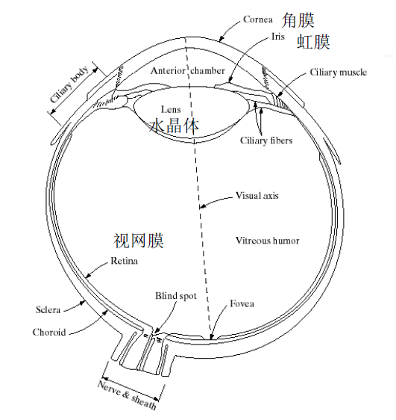
Structure of the Human eye
Diameter:20mm

Slide 5
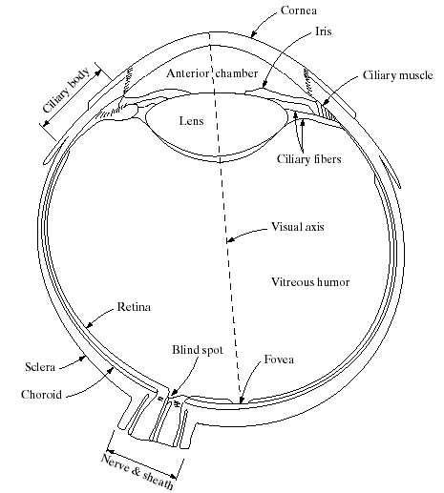
Structure Of The Human Eye
Human eye is nearly a sphere, with an average diameter of approximately 20mm. It has many components.
There are 3 membranes in in the eye: Cornea (眼角膜) and sclera (巩膜) , Choroid(脉络膜) and retina(视网膜).

Slide 6
Structure Of The Human Eye
Cornea and sclera is the outmost membrane, it keeps everything in.
Choroid contains all of the blood vessels that serve as nutrition to the eye
Retina is the innermost membrane, play a great role in the eye.

Slide 7
Structure Of The Human Eye
The iris diaphragm （虹膜膈）
Controls amount of light that enters the eye.
Contains the pigment(色素) that gives our eyes their color.
The central opening in the iris is the pupil.
Blind spot is the region of emergence of the optic nerve from the eye.

Slide 8
Structure Of The Human Eye
The lens
A flexible lens that is different from an ordinary optical lens.
Controlled by the tension in the fibers of the ciliary body(睫状体).
When focus on distant objects, it becomes flattened
When focus on objects near eye, it becomes thicker than before

Slide 9
Structure Of The Human Eye
Retina is covered with light receptors called cones (6-7 million) and rods (75-150 million)
Cones for bright light vision called photopic
Cones are concentrated around the fovea about 1.5x1.5 mm²
Cones involve in color vision.
Rods for dim light vision called scotopic暗视的 .
Rods are sensitive to low level of light and are not involved color vision.

Slide 10
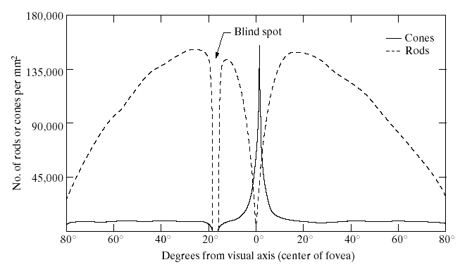
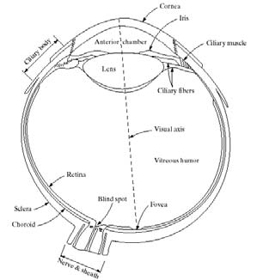
2 classes of receptors: cones and rods
Distribution of cones and rods

Slide 11
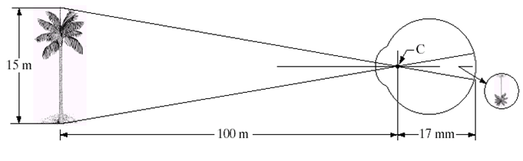
Image formation in the Eye
Muscles within the eye can be used to change the shape of the lens allowing us focus on objects that are near or far away
An image is focused onto the retina causing rods and cones to become excited which ultimately send signals to the brain

Slide 13
Brightness Adaptation & Discrimination
The human visual system can perceive approximately 10¹⁰ different light intensity levels
However, at one time, the visual system cannot operate over such a range. It accomplished this large variation by changing its overall sensitivity, the phenomenon is called brightness adaptation.

Slide 14
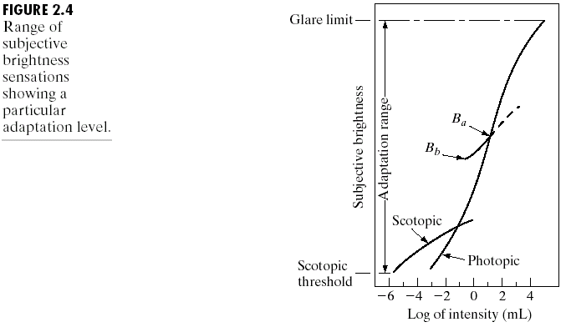
Brightness Adaptation & Discrimination
Scotopic thresshold （暗适应门槛值）

Slide 15
Brightness Adaptation & Discrimination
There are two phenomena clearly demonstrate that perceived brightness is not a simple function of intensity.
Mach bands
Simultaneous contrast

Slide 16
Brightness Adaptation & Discrimination
In 1865, Ernst Mach first describe the phenomenon called Mach bands.
visual system tends to undershoot or overshoot around the boundary of regions of different intensities.

Slide 17
Although the intensity of the stripes is constant, we actually perceive a brightness pattern that is strongly scalloped(扇贝型的) near the boundaries

Slide 18
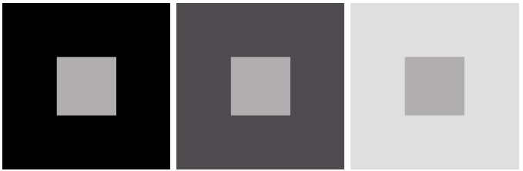
Simultaneous Contrast
A region’s perceived brightness does not depend simply on its intensity.
An example of simultaneous contrast

Slide 19
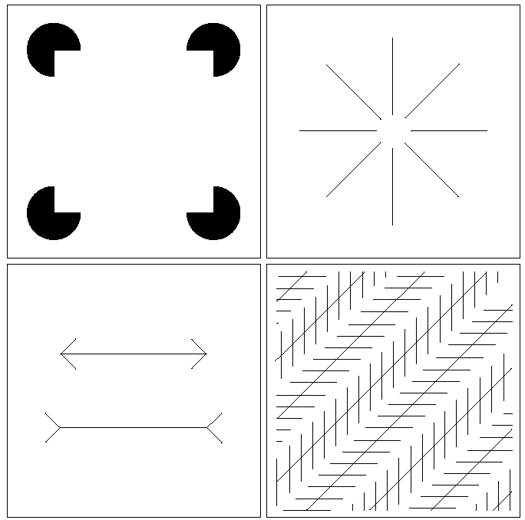
Optical Illusions
Other examples of human perception phenomena are optical illusions, in which the eye fills in nonexisting information or wrongly perceives geometrical properties of objects.

Slide 20
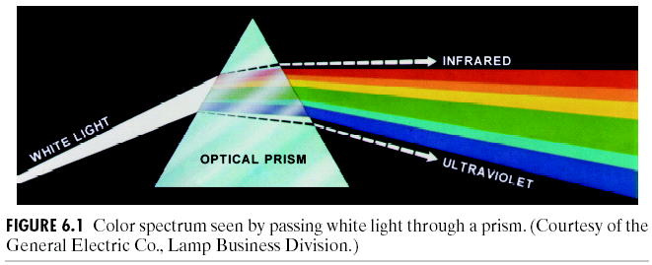
2.2 Light and the Electromagnetic Spectrum
Light is just a particular part of the electromagnetic spectrum that can be sensed by the human eye
Newton, 1666
Violet, Blue, Green, Yellow, Orange, and Red
Notes:
In 1666 Sir Isaac Newton discovered that light passed through a prism splits into a continuous spectrum of colours
Many image applications use electromagnetic radiation that is far outside the visual spectrum – x-ray images, infra-red images – we generate images of these images by mapping them to the visual spectrum.

Slide 21
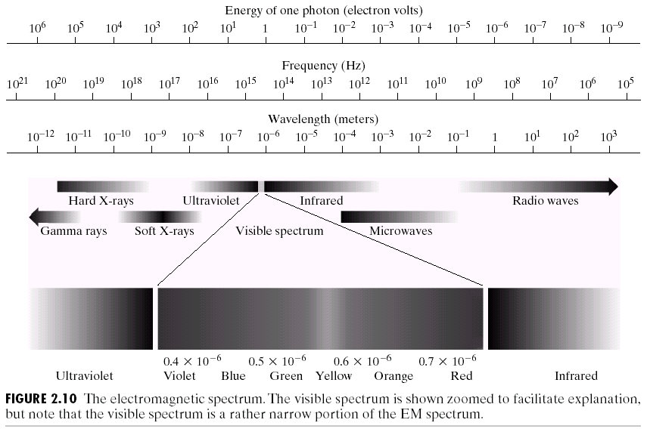

Slide 22
Visible light: 0.43~0.79um
The electromagnetic spectrum is split up according to the wavelengths of different forms of energy
Where c is the speed of the light, v is the frequency, and h is the Planck’s constant

Slide 23
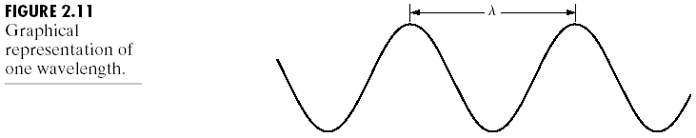
Fig 2.11
EM waves can be thought of a stream of massless particles.
Each massless particle contains a certain amount of energy.
Each bundle of energy is called a photon
High frequency electromagnetic phenomena carry more energy per photon. That is the reason that gamma rays are so dangerous to living organisms.

Slide 24
Light and the Electromagnetic Spectrum
The colours that we perceive are determined by the nature of the light reflected from an object
For example, if white light is shone onto a green object, most wavelengths are absorbed, while green light is reflected from the object
White Light
Colours Absorbed
Green Light

Slide 25
Light reflectance properties
A body that reflects light relatively balanced in all visible wavelengths
appears white to the observer.
A body that favors reflectance in a limited range of the visible spectrum
exhibits some shades of color.

Slide 26
Light reflectance properties
Achromatic or monochromatic light:
the only attribute is intensity (Gray-level)
The intensity is perceived to vary from black to grays and finally to white.
Grey level is used commonly to denote monochromatic intensity.
The range of measured values of monochromatic light from black to white is usually called the gray scale.

Slide 27
Chromatic light
Three basic quantities to describe the quality of a chromatic light source:
Radiance (Watts: W)（发光强度）
The total amount of energy that flows from the light source.
Luminance (lumen: lm)(光通量）
A measure of the amount of energy an observer perceives from a light source.
Example: Far Infrared Region
Brightness
Subjective descriptor of light perception that is practically impossible to measure.

Slide 28
In principle, if a sensor can be developed that is capable of detecting energy radiated by a band of the electromagnetic spectrum, we can image events of interest in that band.
However, the wavelength of an electromagnetic wave require to “see” an object must be of the same size as or smaller than the object.
Electromagnetic waves is not the only method for image generation. Such as sound reflection-> ultrasonic images

Slide 29
2.3 Image Sensing and Acquisition
How images are generated?
Illumination source: EM source illuminate the objects that need to be imaged
Reflection or absorption: object to imaged reflects or absorbs the illumination energy
Sensor: detecting the reflected energy from the objects.

Slide 30
Typical illumination sources:
Visible light
Gamma-ray, x-ray
Infrared, ultravoilet
ultrasonic
Reflection or absorption
Different objects will have different degree of reflections and absorption of the electromagnetic energy.
These differences in reflections and absorption are the reasons for objects to appear distinct in the images.

Slide 31
Sensors
Transform illumination energy into digital images
Type I: single imaging sensor
Type II: line sensor
Type III: array sensor

Slide 32
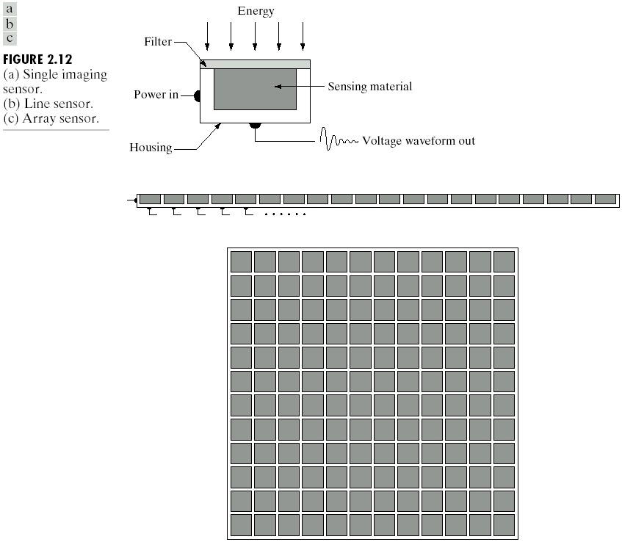

Slide 33

Image Acquisition Using Sensor Arrays

Slide 34
A Simple Image Formation Model
Mathematical representation of monochromatic images.
Two dimensional function f(x,y), where f is the gray level of a pixel at location x and y.
The values of the function f at different locations are proportional to the energy radiated from the imaged object.

Slide 35
0< f(x,y) <∞ Nonzero and Finite
f(x,y)=i(x,y)*r(x,y) Reflectivity
f(x,y)=i(x,y)*t(x,y) Transmissivity
0< i(x,y) <∞
0 ≤ r(x,y) and t(x,y) ≤ 1

Slide 36
Some typical data
i(x,y) : Sun on clear day 90,000 lm/m²
: Sun on cloudy day 10,000 lm/m²
: Full moon 0.1 lm/m²
: Commercial office 1,000 lm/m²
r(x,y) :Black Velvet 0.01
:Stainless Steel 0.65
:Flat-white Wall Paint 0.80
:Silver-plated Metal 0.90
:Snow 0.93

Slide 37
Gray level
The intensity of an image at (x₀, y₀) is the gray level at that point. That is
l = f (x₀, y₀)
It is evident that l lies in the range
L_{min} ≤ l ≤ L_{max}
The requirement on L_{min} is that it be positive, and on L_{max} that it be finite.

Slide 38
Gray scale
The interval [L_{min}, L_{max}] is called gray scale.
It is common to shift this interval numerically to the interval [0, L–1].
l = 0 is considered black;
l = L–1 is considered white.

Slide 39
2.4 image sampling and quantization
Incoming energy lands on a sensor material responsive to that type of energy and this generates a continuous voltage
To create a digital image, we need to convert the continuous sensed data into digital form.
Why? Limited representation power in digital computers

Slide 40
Creating digital image involves two steps: sampling and quantization.
Sampling: Digitizing the coordinate values is called sampling.
Quantization: digitizing the amplitude values is called quantization
continuous
data
discretize
digital
data

Slide 42

Sometimes, the sampling and quantization are done mechanically
sensor
array

Slide 43
Representing digital images
Let Z be the set of real integers
R the set of real numbers
Sampling:
Partition the xy plane into a grid.
The coordinates of the center of each grid being a pair of elements from the Cartesian product Z².
The set of all ordered pairs of elements (z_{i}, z_{j}). With z_{i} and z_{j} being integers from Z.
Quantization:
f is a function that assigns a gray-level value (a real number in R) to each distinct pair of coordinate (x, y).

Slide 44
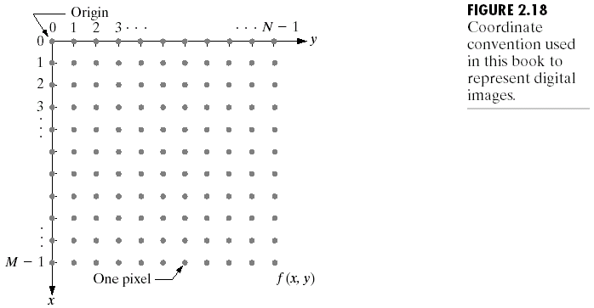
Representing digital images
Sampling coordinates

Slide 45
Matrix notation of a digital image
f(0,0) f(0,1) … f(0,N-1)
f(1,0) f(0,1) … f(1,N-1)
…
…
f(M-1,0) f(M-1,1) … f(M-1,N-1)
MxN

Slide 46
Usually, the M and N are positive integers, and the number of gray levels is an integer power of 2:
Both spatial and gray level resolutions determine the storage size of an image (bytes)
e.g. spatial resolution: 40 x 40
gray level resolution: 64 (log₂64 = 6 bits/pixel)
– The number of pixels:
40 x 40 = 1600 pixels
– The storage size (no compression, no overhead):
1600 x 6 = 9600 bits = 1200 bytes ≈ 1.17 KB

Slide 47
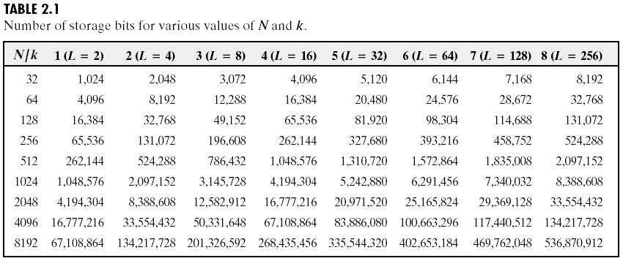
Representation

Slide 48
Spatial & Intensity Level Resolution
Spatial resolution is a measure of the smallest discernible detail in an image
Vision specialists often talk about pixel size
Dots per inch (DPI) is used commonly in the printing and publishing industry
Notes:
Discernible [dɪˈsə:nəbəl] 可识别的，可辨别的。
There are TWO resolutions for any digital image. The first and most important is IMAGE resolution which is the actual pixel dimensions. The second is PRINT or DOCUMENT resolution, also known as OUTPUT resolution . Print/output resolution scales the existing pixel dimensions to a requested print or document size.

Slide 49
Spatial & Intensity Level Resolution
Image size commonly stated with the number of pixel. It imply different images have approximate pixel size.
the more pixels in a fixed range, the higher the resolution
Under the same physical dimension of one pixel, the more pixels one image has, the larger the size of the image.
Notes:
Discernible [dɪˈsə:nəbəl] 可识别的，可辨别的。

Slide 50
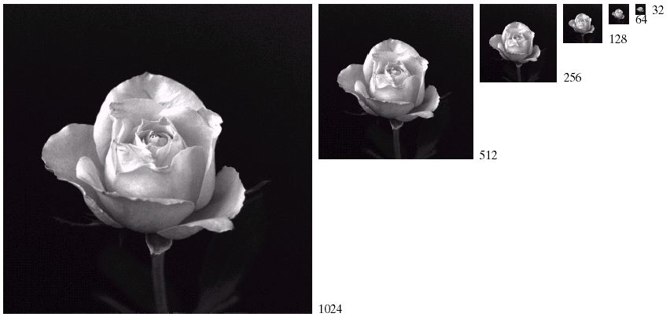
Spatial & Intensity Level Resolution
An example of different image resolution

Slide 51
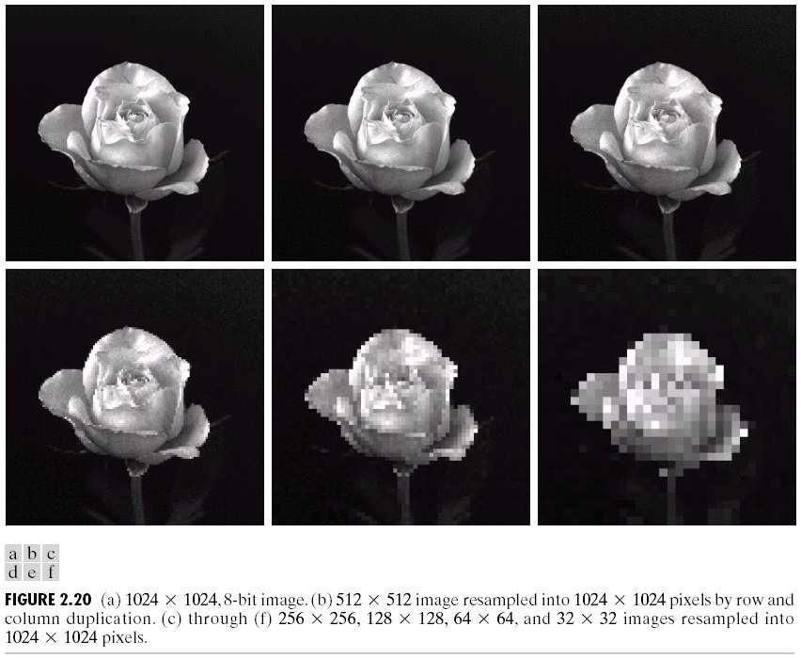
Low resolution tends to blur image
1024 * 1024
512 * 512
256 * 256
128 * 128
64 * 64
32 * 32
Notes:
When we zoom in these pictures to the same size, it can be find the image with low resolution is blurred and the image with high resolution is clear.

Slide 52
Spatial & Intensity Level Resolution
Intensity level resolution refers to the number of intensity levels used to represent the image
The more intensity levels used, the finer the level of detail discernible in an image
Intensity level resolution is usually given in terms of the number of bits used to store each intensity level

Slide 53
Spatial & Intensity Level Resolution
Relation between store bits and number of intensity levels
Number of Bits
Number of Intensity Levels
Examples
1
2
0, 1
2
4
00, 01, 10, 11
4
16
0000, 0101, 1111
8
256
00110011, 01010101
16
65,536
1010101010101010

Slide 54
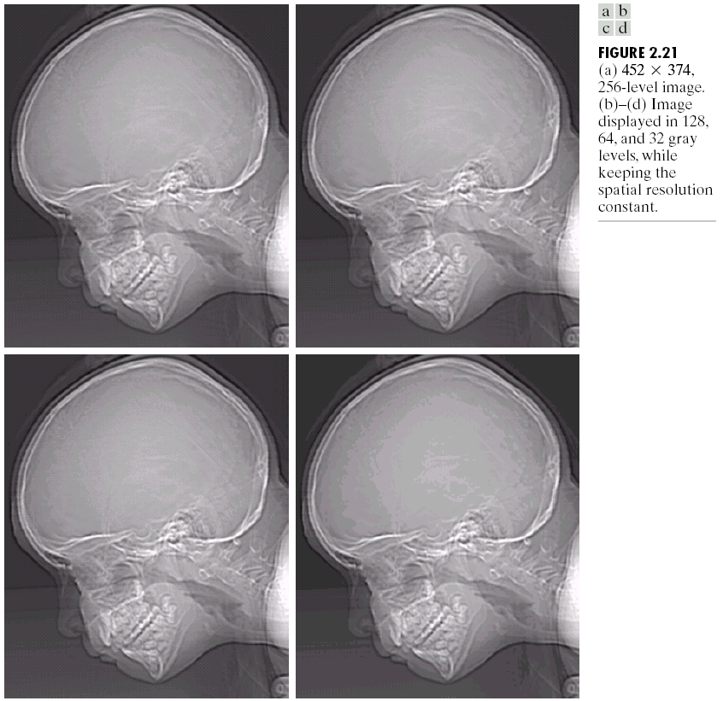
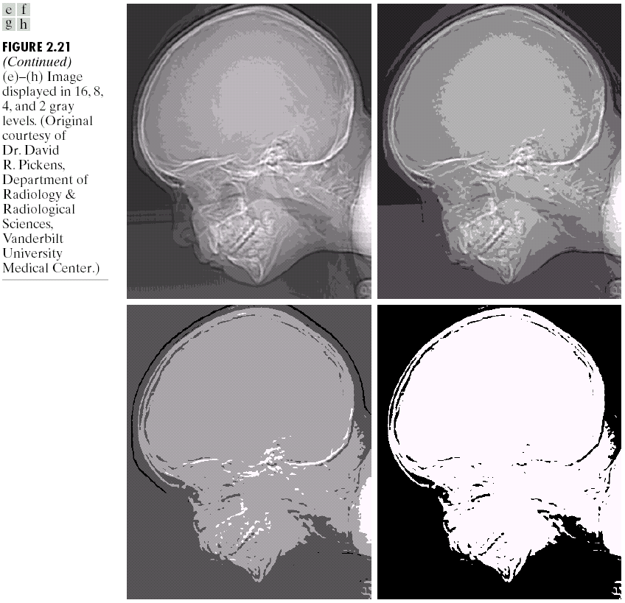
256 grey levels (8 bits per pixel)
128 grey levels (7 bpp)
64 grey levels (6 bpp)
32 grey levels (5 bpp)
16 grey levels (4 bpp)
8 grey levels (3 bpp)
4 grey levels (2 bpp)
2 grey levels (1 bpp)

Slide 55
Spatial & Intensity Level Resolution
Spatial resolution: M*N
Gray level resolution：L
How many samples and gray levels are required for a good approximation?
Resolution (the degree of discernible detail) of an image depends on sample number and gray level number.
i.e. the more these parameters are increased, the closer the digitized array approximates the original image.
But: storage & processing requirements increase rapidly as a function of N, M, and k

Slide 56
Spatial & Intensity Level Resolution
The big question with resolution is always: “how much is enough?”
This all depends on what is in the image and what you would like to do with it
Key questions include
Does the image look aesthetically pleasing?
Can you see what you need to see within the image?

Slide 57
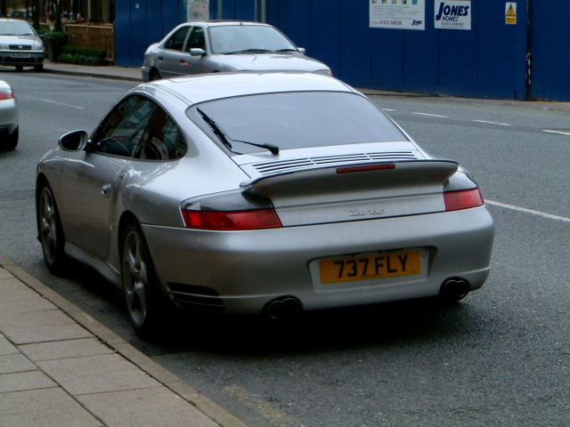

Spatial & Intensity Level Resolution
The picture on the right is fine for counting the number of cars, but not for reading the number plate

Slide 58
Image interpolation
Interpolation is a basic tool used extensively in tasks such as zooming, shrinking, rotating, and geometric corrections.
Interpolation is the process of using known data to estimate values at unknown locations.

Slide 59
Image interpolation
Our principle objective in this section is to introduce interpolation and apply it to image resizing(shrinking and zooming), which are basically image resampling methods.

Slide 60
Image interpolation
Interpolation in zooming
Suppose that an image of size 3X3 pixels has to be enlarged to 5X5 pixels.
(1) Create an imaginary 5X5 grid with the same pixel spacing as the original
(2)Shrink it so that it fits exactly over the original image.
(3)Look for the closest pixel in the original image and assign the intensity of that pixel to the new pixel in the 5X5 grid

Slide 61
(1)The creation of new pixel locations
(2)The assignment of gray levels to those new locations
Nearest neighbor interpolation (NN)
Pixel replication: a special case of NN
NN
Gray level

Slide 62
Bilinear interpolation
Using the four NNs of a point.
G(A), G(B), G(C), G(D) are the
gray levels of pint A, B, C, D.
(i,j ) is the coordinate of point A

Slide 63
Bicubic interpolation
Involves the sixteen NNs of a point.
The intensity value assigned to point (x,y) is obtained using the equation
Where, are determined from the sixteen equations in sixteen unknowns that can be written using the sixteen nearest neighbors of point (x,y).

Slide 64
Generally, bicubic interpolation does a better job of preserving fine detail than its bilinear counterpart.
Bibubic interpolation is the standrad used in commercial image editing programs, such as Adobe Photshop and Corel Photopaint.
Bicubic interpolation is covered in the classic book.
William H. Press, Saul A. Teukolsky, et al. Numerical Recipes 3rd Edition: The Art of Scientific Computing. Cambridge University Press, 2007

Slide 65
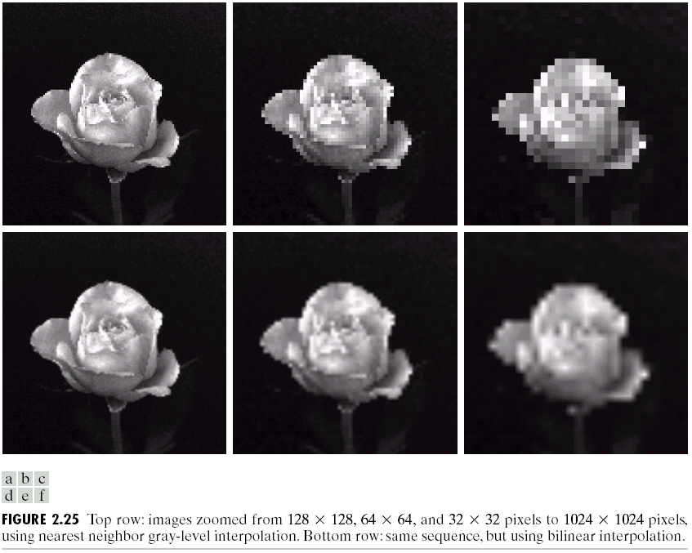

Slide 66
Shrinking: Similar manner as just described for zooming.
Delete
Expand the grid:
Nearest Neighbor interpolation
Bilinear interpolation

Slide 67
Basic Relationships Between Pixels
(0,0)
x
(x-1,y-1)
(x,y-1)
(x+1,y-1)
(x-1,y)
(x,y)
(x+1,y)
y
(x-1,y+1)
(x,y+1)
(x+1,y+1)
Conventional indexing method

Slide 68
Basic Relationships Between Pixels
 | N₄
N₄ | P | N₄
 | N₄
Definitions:
f(x,y): digital image
Pixels: q, p
A pixel p at (x,y) has 2 horizontal and 2 vertical neighbors:
(x+1,y), (x-1,y), (x,y+1), (x,y-1)
This set of pixels is called the 4-neighbors of p: N₄(p)
4-neighborhood relation considers only vertical and horizontal neighbors.
Note: q ∈ N₄(p) implies p ∈ N₄(q)

Slide 69
Basic Relationships Between Pixels
The 4 diagonal neighbors of p are: (N_{D}(p))
- (x+1,y+1), (x+1,y-1), (x-1,y+1), (x-1,y-1)
N_{D} |  | N_{D}
 | P
N_{D} |  | N_{D}
(x−1,y−1)
(x+1,y−1)
(x−1,y+1)
(x+1,y+1)
N_{D}(p) =
Diagonal -neighborhood relation considers only diagonal
neighbor pixels.

Slide 70
Basic Relationships Between Pixels
The 8-neighbors of p are: (N₈(p))
- N₄(p) + N_{D}(p)
(x−1,y−1)
(x,y−1)
(x+1,y−1)
(x−1,y)
(x+1,y)
(x−1,y+1)
(x,y+1)
(x+1,y+1)
(x-1,y-1)
(x,y-1)
(x+1,y-1)
N₈(p) =
(x-1,y)
p
(x+1,y)
(x-1,y+1)
(x,y+1)
(x+1,y+1)
8-neighborhood relation considers all neighbor pixels.

Slide 71
Basic Relationships Between Pixels
0 | 0 | 0 | 0 | 0 | 0 | 0 | 0 | 0 | 0 | 0 | 0
0 | 0 | 0 | 1 | 1 | 0 | 0 | 0 | 0 | 0 | 0 | 0
0 | 0 | 1 | 1 | 1 | 1 | 1 | 0 | 0 | 0 | 0 | 0
0 | 1 | 1 | 1 | 1 | 1 | 1 | 1 | 0 | 0 | 0 | 0
0 | 1 | 1 | 1 | 1 | 1 | 1 | 1 | 0 | 0 | 0 | 0
0 | 0 | 1 | 1 | 1 | 1 | 1 | 1 | 0 | 0 | 0 | 0
0 | 0 | 1 | 1 | 1 | 1 | 1 | 1 | 1 | 0 | 0 | 0
0 | 0 | 1 | 1 | 1 | 1 | 1 | 1 | 1 | 1 | 1 | 0
0 | 0 | 0 | 0 | 0 | 1 | 1 | 1 | 1 | 1 | 1 | 0
0 | 0 | 0 | 0 | 0 | 0 | 0 | 0 | 0 | 0 | 0 | 0
Q
N_{D}(p)
P
N₈(p)
S
N₄(p)

Slide 72
Connectivity
Connectivity between pixels is important:
Because it is used in establishing boundaries of objects and components of regions in an image
Two pixels are connected if:
They are neighbors (i.e. adjacent in some sense -- e.g. N₄(p), N₈(p), …)
Their gray levels satisfy a specified criterion of similarity (e.g. equality, …)

Slide 73
Adjacency(邻接)
Adjacency
Let V be the set of gray-level values used to define adjacency. Three types of adjacency:
4-adjacency. Two pixels p and q with values from V are 4-adjacent if q is in the set N₄(p).
8-adjacency. Two pixels p and q with values from V are 8-adjacent if q is in the set N₈(p).
m-adjacency (mixed adjacency). Two pixels p and q with values from V are m -adjacent if
q is in N₄( p), or
q is in N₈( p) and the set N₄( p)∩N₄(q) has no pixels whose values are from V.

Slide 74
Adjacency
Mixed adjacency is a modification of 8-adjacency and is used to eliminate the multiple path connections that often arise when 8-adjacency is used.
V={1}
8-adjacency
m-adjacency

Slide 75
Path(通路)
Path
A (digital) path or curve from p with (x, y) to q with (s, t) is a sequence of distinct pixels with
(x₀, y₀), (x₁, y₁),…, (x_{n}, y_{n})
where (x₀, y₀) = (x, y) and (x_{n}, y_{n}) = (s, t), and pixels (x_{i −1}, y_{i −1}) and (x_{i}, y_{i}) are adjacent for 1≤i≤n.
In this case, n is the length of the path.
If (x₀, y₀) = (x_{n}, y_{n}), the path is a closed path.
We can define 4-, 8-,or m-path depending on the type of adjacency specified.

Slide 76
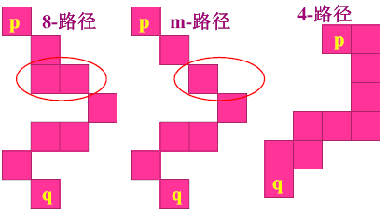
Path
4-Path
8-Path
m-Path

Slide 77
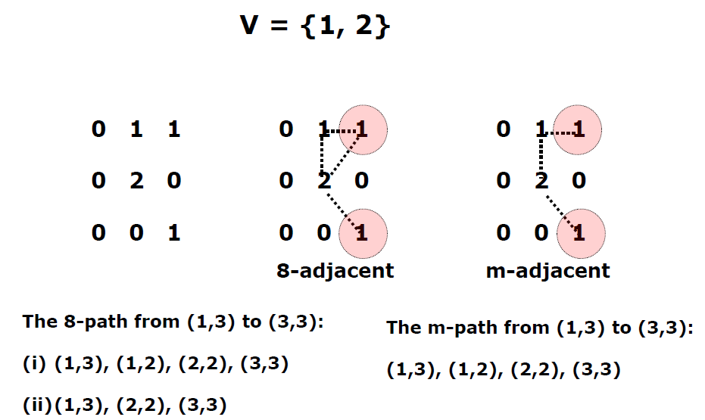
Examples: Adjacency and Path

Slide 78
Connected Set and Region
Connectivity
Let S be a subset of pixels in an image. Two pixels p and q are said be connected(连通的) in S if there exists a path between them consisting entirely of pixels in S.
For any pixel p in S, the set of pixels that are connected to it in S is called a connected component （连通分量）of S.
If it has only one connected component, then set S is called a connected set（连通集）.

Slide 79
Connected Set and Region
Definitions:
Let R be a subset of pixels in an image. We also called R a region(区域) of the image if R is a connected set.
Two regions, R_{i} and R_{j} are said to be adjacent if their union forms a connected set. Regions that are not adjacent are said to be disjoint.

Slide 80
Connected Set and Region
Definitions:
Suppose that an image contains K disjoint regions, R_{k}, k=1,2,…,k, none of which touches the image border. Let R_{u} denote the union of all the K regions, and let (R_{u})^{c} denote its complement (recall that the complement of a set s is the set of points that are not in S). We call all the points in R_{u} the foreground, and all the points in (R_{u})^{c} the background of the image.

Slide 81
Connected Set and Region
Definitions:
The boundary(边界，或边缘、轮廓) of a region R is the set of pixels in the region that have one or more neighbors that are not in R. it is also called the border or contour.

Slide 82
Connected Set and Region
Definitions:
The preceding definition sometimes is referred to as the inner border of the region to distinguish it from its outer border, which is the corresponding border in the background.
The distinction is important in the development of border-following algorithms. Such algorithms usually are formulated to follow the outer boundary in order to guarantee that the result will form a closed path.

Slide 83
Connected Set and Region
Definitions:
The concept of edge is found frequently in discussions dealing with regions and boundaries.
There is a key difference between the two concepts.
The boundary of a finite region forms a closed path and is thus a “global” concept.
Edges are formed form pixels with derivative values that exceed a preset threshold. The idea of an edge is a “local” concept.
Notes:
Concept [ˈkɑnˌsɛpt]

Slide 84
Distance Measures
For pixels p, q and z, with coordinates (x, y), (s, t) and (v, w), respectively, D is a distance function if
(a) D(p, q) ≥ 0 (D(p, q) = 0 iff p = q),
(b) D(p, q) = D(q, p), and
(c) D(p, z) ≤ D(p, q) + D(q, z).

Slide 85
Distance Measures
Three different ways to calculate distance depending upon the traversing criteria of pixels are ：
Euclidean distance
City-block distance or D4 distance.
D8 distance or chessboard distance.
Notes:
Traversing [ˈtrævəsɪŋ] 穿越、横贯

Slide 86
Distance Measures
Euclidean distance between p and q is defined as
The pixels with D_{e} distance ≤ 3 from (x, y)
Disk

Slide 87
Distance Measures
The D₄ distance (also called city-block distance) between p and q is defined as
The pixels having a distance D4 from (x, y) less than or equal to some value r from a diamond centered at (x, y).
E.g the pixels with D4 distance <=2 from (x, y) (the center point) form the following contours of constant distance
Diamond

Slide 88
Distance Measures
The D₈ distance (also called chessboard distance) between p and q is defined as
The pixels having a D8 distance from (x, y) less than or equal to some value r form a square centered at (x, y).
E.g the pixels with D8 distance <=2 from (x, y) (the center point) form the following contours of constant distance The pixels with D8 = 1 are the 8-neighbors of (x, y)
Square

Slide 89
Common Distance Definitions
Euclidean distance
(2-norm)
D₄ distance
(city-block distance)
D₈ distance
(checkboard distance)
2
4
3
2
3
4
2
2
2
2
2
1
3
2
1
2
3
2
1
1
1
2
2
1
0
1
2
2
1
0
1
2
2
1
0
1
2
1
3
2
1
2
3
2
1
1
1
2
2
4
3
2
3
4
2
2
2
2
2

Slide 90
A introduction to the mathematical tools used in DIP
Array versus matrix operations
Linear versus nonlinear operations
Arithmetic operations
Set and logical operations
Spatial operations
Vector and matrix operations

Slide 91
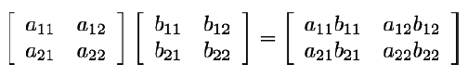
Array versus matrix operations
Array operation: on a pixel-by-pixel basis
(NB: distinction between array and matrix operations)
Array product of 2 images A and B:
(compare with the matrix product…)

Slide 92
Linear versus nonlinear operations
A linear operator
Let H be an operator whose input and output are images. H is said to be linear if and only if, for any two images f and g and any two scalars a and b,
H(a f +b g) = a H( f ) + b H( g )
An operator that does not meet this condition is nonlinear by definition.

Slide 93
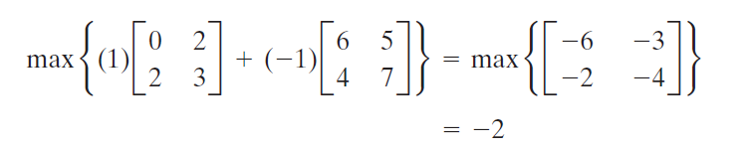
Linear versus nonlinear operations
Examples
(1) The sum operator is linear
(2) The max operation is nonlinear

Slide 94
Arithmetic operations
Arithmetic Operations
s(x,y) = f(x,y) + g(x,y)
d(x,y) = f(x,y) - g(x,y)
p(x,y) = f(x,y) x g(x,y)
v(x,y) = f(x,y) ÷g(x,y)
These operations are performed between corresponding pixels in f and g, for x= 0,1,2…M-1 and y = 0,1,2…N-1, M and N are the row and column sizes of the images
NB: s, d, p and v are images of the same size

Slide 95
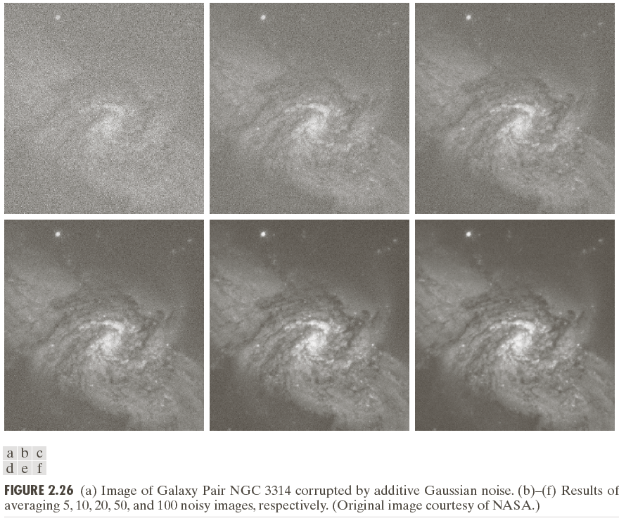
Arithmetic operations
Addition

Slide 96
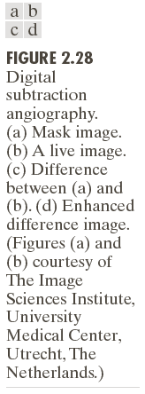
Arithmetic operations:
Subtraction

Slide 97
An important application of image multiplication (and division) is shading correction (阴影校正).
The image might be darker on the left side and lighter on the right side. This is shading.
The shading might be caused by non-uniform illumination, non-uniform camera sensitivity, or even dirt and dust on glass (lens) surfaces. In general this shading effect is undesirable. Removing the shading is shading correction.

Slide 98
Suppose the ideal image of objects is f(x, y), the shading pattern is described by function h(x, y) , the image produced by image sensor is g(x, y), we get
g(x, y)=f(x, y)h(x, y)
If h(x, y) is known, we can obtain f(x, y) by dividing g by h.

Slide 99
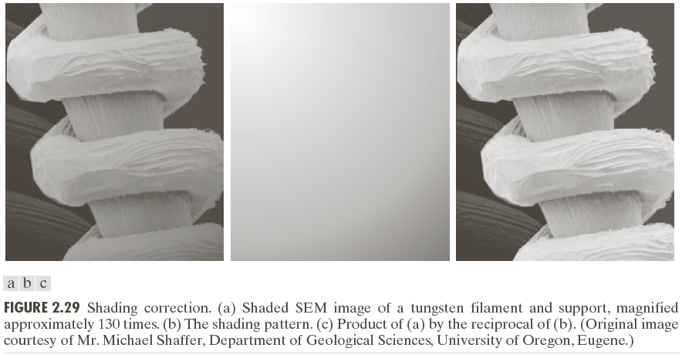
Shading correction

Slide 100
Another common use of image multiplication is in masking, also called region of interest (ROI), operations.
The process can highlight the ROI in one image.

Slide 101
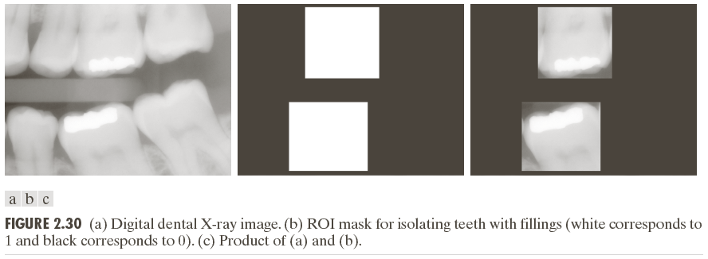
Image multiplication

Slide 102
Set and logical operation
A set is a collection of objects, with each object in a set often referred to as an element or member of the set. Familiar examples include the set of all image processing books in the world, the set of prime numbers, and the set of planets circling the sun. Typically, sets are represented by uppercase letters, such as A, B, and C, and members of sets by lowercase letters, such as a, b, and c.

Slide 103
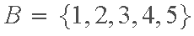
Set and logical operation
We denote the fact that an element a belongs to set A by
If a is not an element of A, then we write
A set can be specified by listing all of its elements, or by listing properties common to all elements. For example, suppose that I is the set of all integers. A set B consisting the first five nonzero integers is specified using the notation

Slide 104

Set and logical operation
The set of all integers less than 10 is specified using the notation
which we read as "C is the set of integers such that each members of the set is less than 10." The "such that" condition is denoted by the symbol “ | “ . As shown in the previous two equations, the elements of the set are enclosed by curly brackets.
The set with no elements is called the empty or null set, denoted in this review by the symbol Ø.

Slide 105



Set and logical operation
Two sets A and B are said to be equal if and only if they contain the same elements. Set equality is denoted by
If the elements of two sets are not the same, we say that the sets are not equal, and denote this by
If every element of B is also an element of A, we say that B is a subset of A:

Slide 106
Set and logical operation
Finally, we consider the concept of a universal set, which we denote by U and define to be the set containing all elements of interest in a given situation

Slide 107



Set and logical operation
The union of two sets A and B, denoted by
is the set of elements that are either in A or in B, or in both. In other words,
Similarly, the intersection of sets A and B, denoted by
is the set of elements common to both A and B; that is,

Slide 108


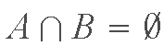

Set and logical operation
Two sets having no elements in common are said to be disjoint or mutually exclusive, in which case
The complement of set A is defined as
Clearly, (A^{c})^{c}=A. Sometimes the complement of A is denoted as .
The difference of two sets A and B, denoted A − B, is the set of elements that belong to A, but not to B. In other words,

Slide 109
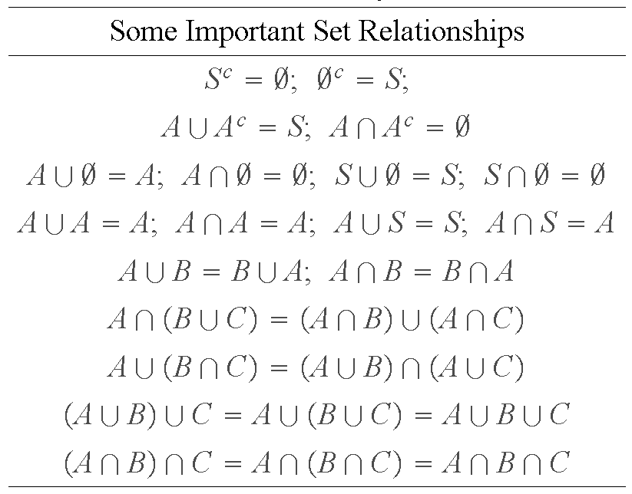
Set and logical operation

Slide 110
Set operations
Notes:
NB: the grey area is result.

Slide 111
Complements

Slide 112
logical operations
Logical operations are used to deal with binary images.
Binary image refers to an image which has only two gray level: 0 and 1. also called black white image.
When dealing with binary images, it is common practice to refer to set operations as logical operations.

Slide 113
Logical operations

Slide 114
Spatial operations
3 broad categories:
a) Single-pixel operations
b) Neighbourhood operations
c) Geometric spatial transformations

Slide 115
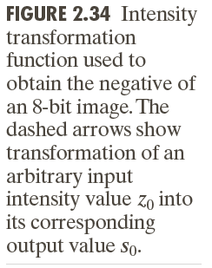
Single-pixel operations

Slide 116
Neighborhood operations
Let S_{xy} denote the set of coordinates of a neighborhood centered on an arbitrary point (x, y) in an image, f. Neighborhood processing generates a corresponding pixel at the same coordinates in an output (processed) image, g, such that the value of that pixel is determined by a specified operation involving the pixels in the input image with coordinates in S_{xy}

Slide 117
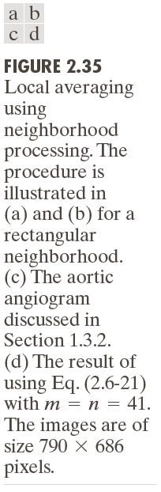
Neighborhood operations

Slide 118
Geometric spatial transformation and image registration
Geometric transformation: 2 basic operations:
1. Spatial transformation of coordinates (x,y)=T{(v,w)}
2. Intensity interpolation that assigns intensity values to the spatially transformed pixels
Example of spatial transformation : (x,y)=T{(v,w)}=(v/2,w/2)
Shrinks the original image to half its size in both spatial directions

Slide 119
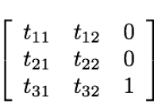
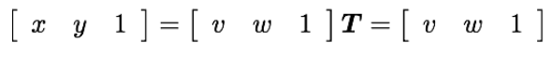
Geometric spatial transformation and image registration
Affine transform (仿射变换)general form:
Can scale, rotate, translate, sheer…
(2.6-23)

Slide 120
Affine transformations

Slide 121
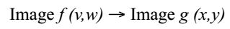
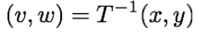
Intensity interpolation
a) Forward mapping: scan the pixels of f and at each location (v,w) compute the spatial location (x,y) of the corresponding pixel in g using Eq. (2.6-23) directly .
b) Inverse mapping: scan the output pixel locations and at each (x,y) compute the corresponding location in f using
then interpolate among the nearest input pixels to determine the intensity of the output pixel value

Slide 122
Inverse mapping

Slide 123
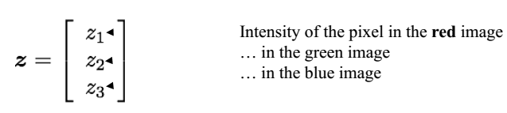

Vector and matrix operations
Multispectral image processing
e.g.: colour images formed in RGB colour space: Red, Green and Blue component images
Each pixel of an RGB image has 3 components:

Slide 124
Vector operations

Slide 125
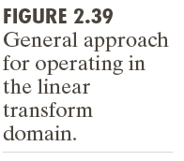
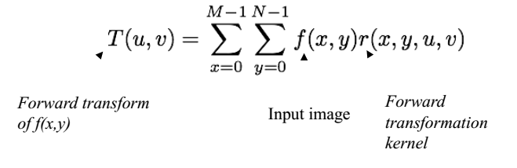
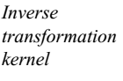
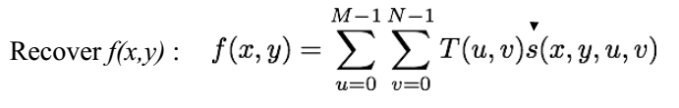
Image transforms

Slide 126
Fourier transform

Slide 127
Summary
We have looked at:
Human vision system
Light and Electromagnetic spectrum
Image acquisition
Sampling and Quantization
Resolution
Basic Relationships Between Pixels
Mathematical tools used in DIP

Slide 128
Homework
pp.121-125
2.1, 2.3, 2.5, 2.11, 2.12, 2.15

